Slide 1
EMPLOYEE SALES DATA ANALYSIS USING EXCEL
STUDENT NAME: I.NAJIA KHATUN REGISTER NO:312208531 ASUNM1330312208531 DEPARTMENT: B.COM(GENERAL) COLLEGE: CHELLAMMAL WOMEN’S COLLEGE

Slide 2
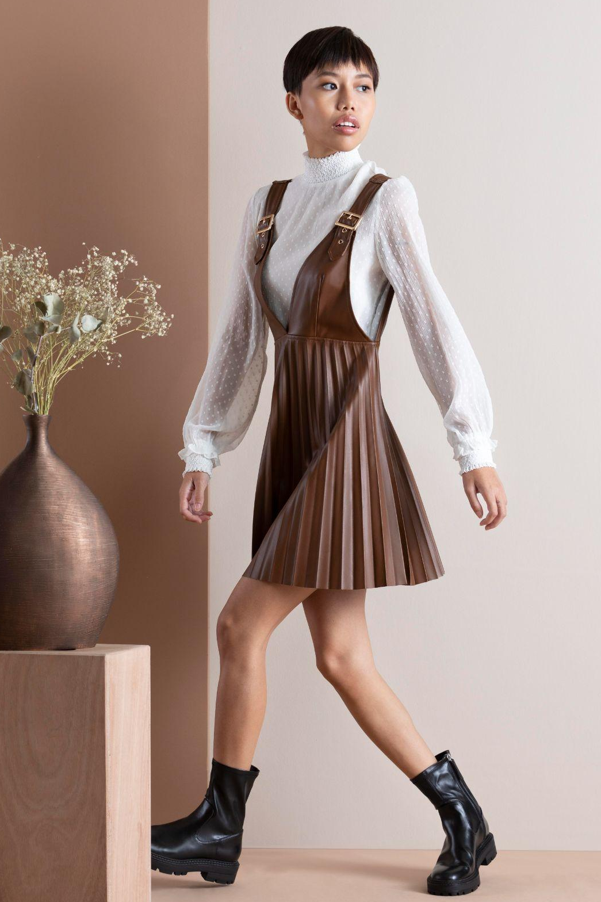

MODERN CLOTHING CATALOG.
NAZIYA TEXTILE
@modernclothing
@modernclothing

Slide 3

PROJECT TITLE
SALES ANALYSIS REPORT
DEALER WISE SALES ANALYSIS
YEAR-2023-2024
REGION-INDIA

Slide 4
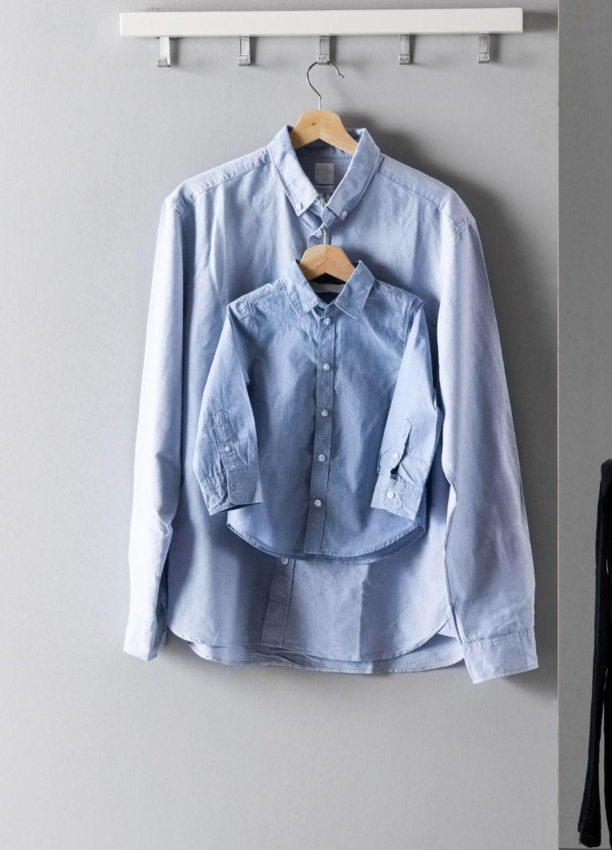

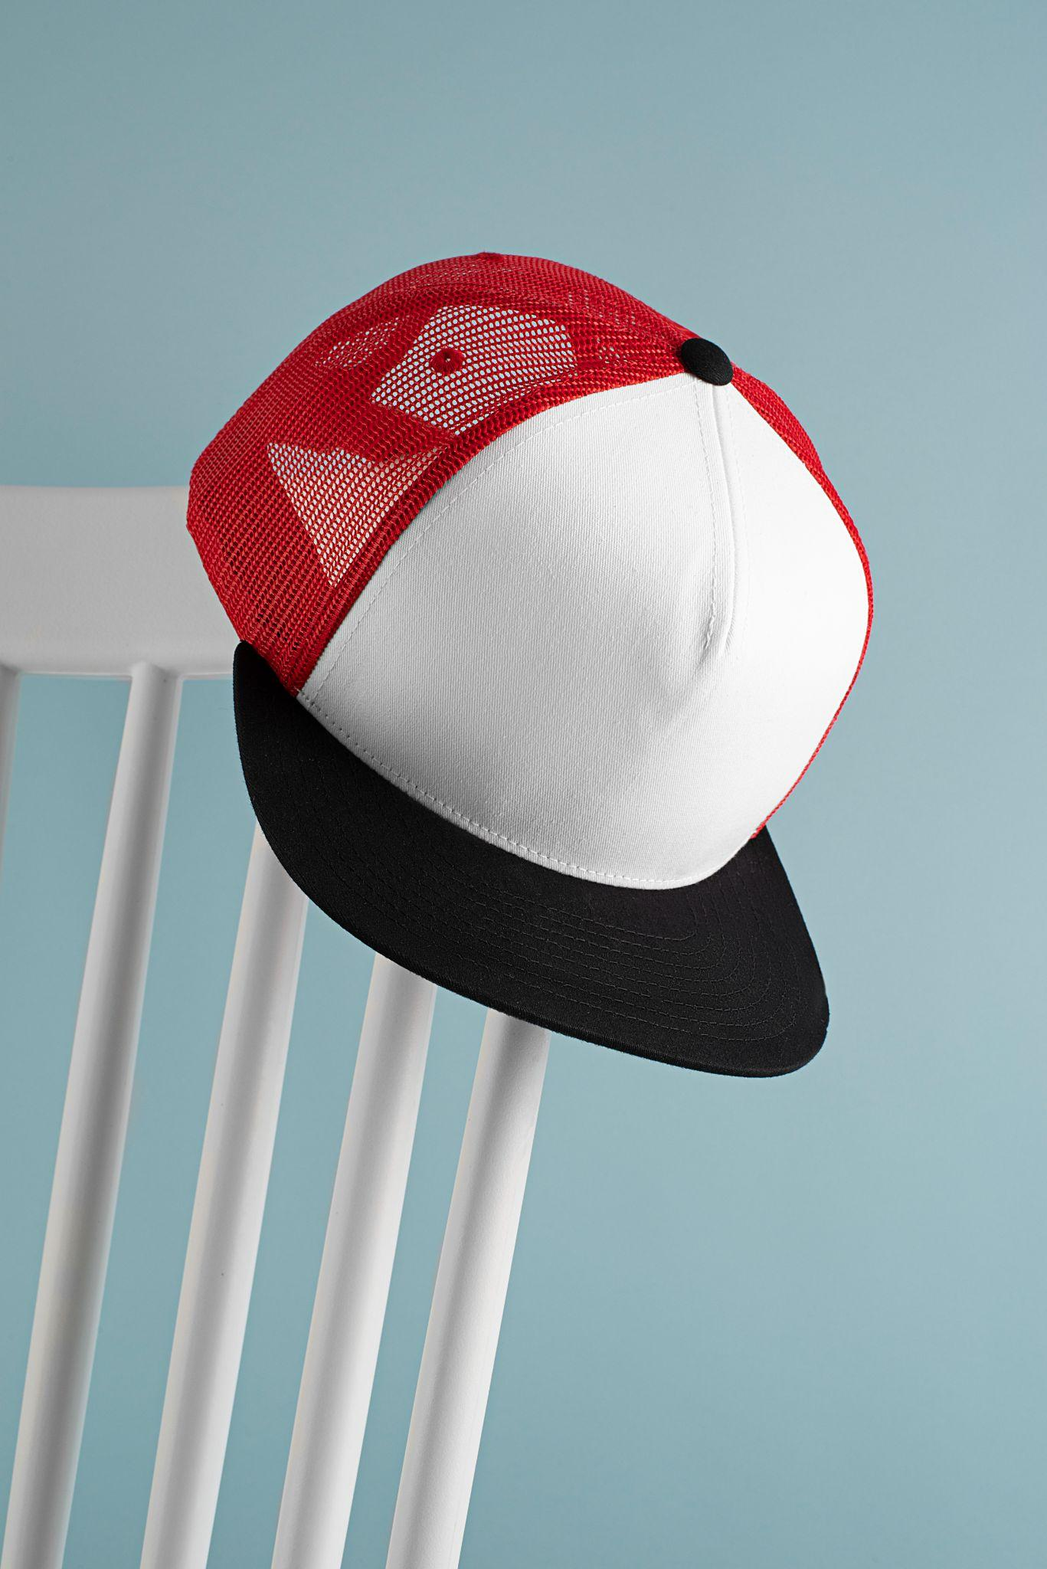
TABLE OF CONTENTS
01
02
03
04
ABOUT US
PRODUCTS
DEALS
MORE INFO
We are providing cheap and best product
Brand new shirts
Imported shoes
Silk cap

Slide 5
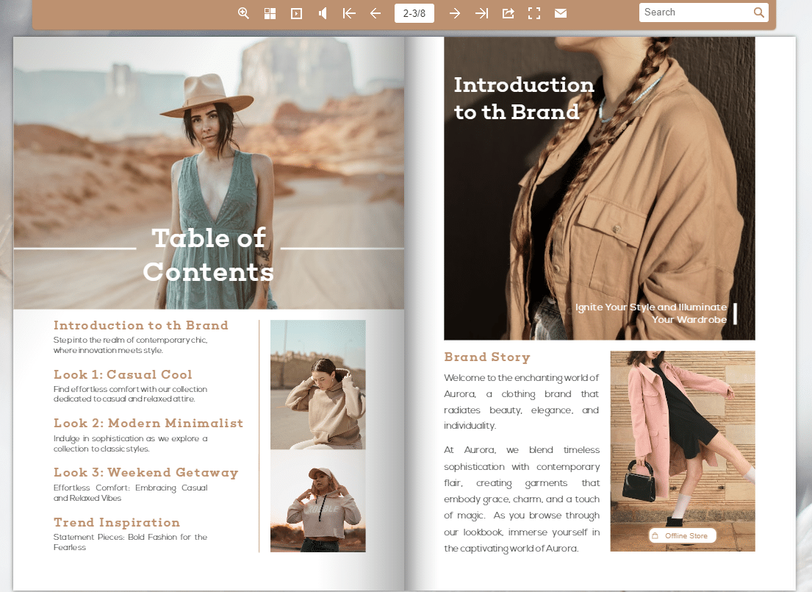

Slide 6
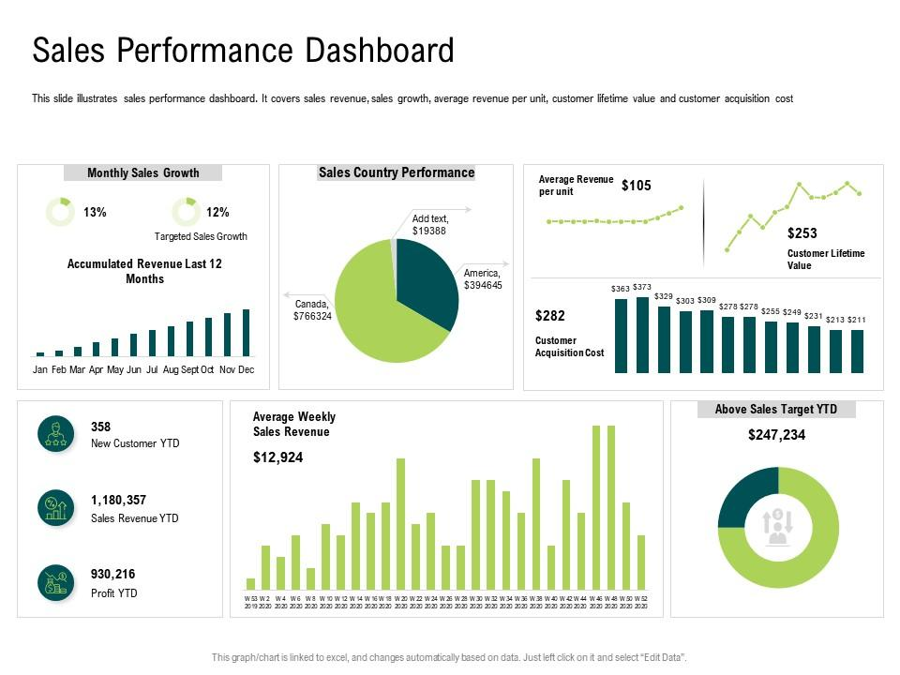
SALES PERFOMANCE ANALYSIS REPORT

Slide 7

WHY CHOOSE US?
MARS
VENUS
JUPITER
SATURN
Mercury is the closest planet to the Sun and the smallest one in the Solar System—it’s only a bit larger than the Moon
Mars is actually a very cold place
Venus has extremely high temperatures
It’s the biggest planet in the Solar System
Saturn is a gas giant and has several rings

Slide 8

NORTH COSTUMES
PUJABI GHAGRA
SALWAR KAMEEZ
CHURIDAR
ANAGKHA
ANARKALI SALWAR SUIT
MEKLHELA CHADOR

Slide 9
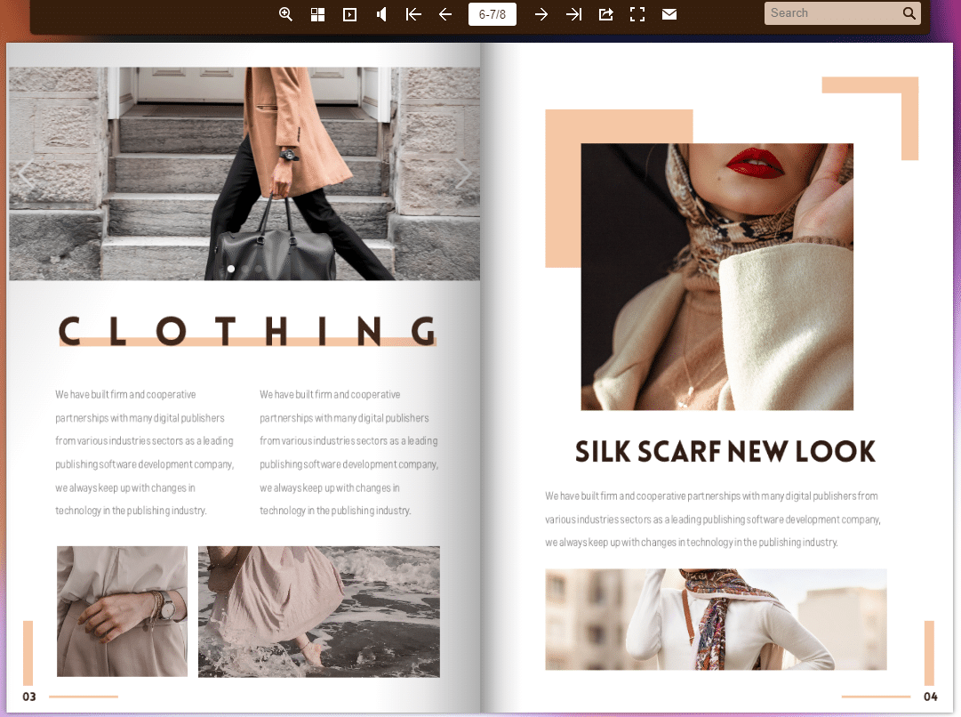

Slide 10

LOOKBOOK
ADOBE INDESIGN
LANDSACAPE ORIENTATION
A4 PAPER SIZE
EASY TO CUSTOMIZE

Slide 11

A PICTURE IS WORTH A THOUSAND WORDS

Slide 12


AWESOME PRODUCT.
@modernclothing
@modernclothing

Slide 13


THANKS.
@modernclothing
Do you have any questions?
addyouremail@freepik.com
+91 620 421 838
yourwebsite.com
Please keep this slide for attribution
@modernclothing

